Slide 1
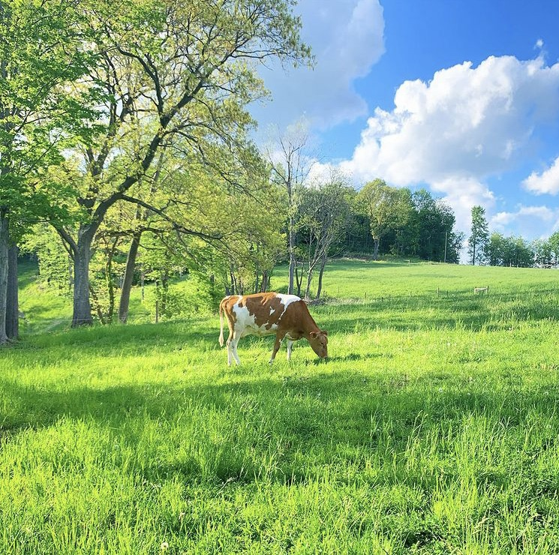
Your First Family Milk Cow
Notes:
Here’s a classified job I found, I’m sure someone here would be interested in applying.
Wanted: motivated individual, self starter. mostly half days, you choose. 5-5, 6-6. Guaranteed overtime on weekends and holidays.. There will be emergency hours as well usually during a blizzard or heat wave. Or whenever you have other plans.
The work environment is peaceful, soothing, downright idyllic.
Might even say restful. You will never need a vacation again. Which is good, cause you get no time off.
You’ll have to do a whole lot of jobs with 0 training and no experience. These include but are not limited to, veterinary procedures, food safety and nutrition, mechanical engineering. University of YouTube best friend.
Salary is 0$., but there are benefits! No gym membership, but lots of weight lifting. You get unlimited access to a priceless product (that the government regulates the price of) but unfortunately it is highly restricted sometimes outright illegal to consume and no one will want to pay the true value of it.
Best to say, the boss can be pushy and unpredictable. She’s a hormonal, powerful female, so If that intimidates you, need not apply. Stepping on toes. Downright hostile occasionally, but also very very sensitive. You have to be the same every day, calm, collected , no surprises, nerver lose your temper. Even though she can be a real cow sometimes.
Honestly, I don’t even know how she has this position. Must be the big udder.
So who wants the job? Who wants a family milk cow? You’re all crazy! And I’m allowed to say that, because I took the job too.
So we’re gonna be co workers!

Slide 2
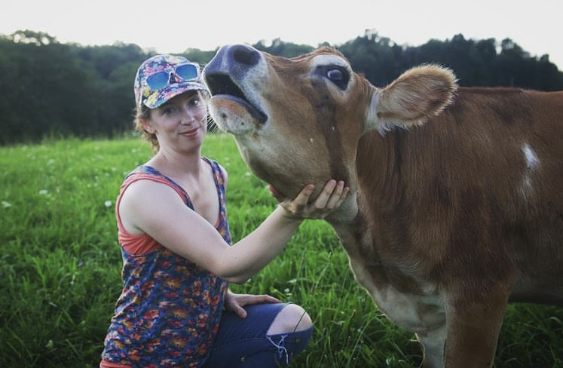
Are you ready for a cow?
Notes:
Why? Reasons to get one
Milk, control
Do you want one? Why can’t you?
What’s holding you back?
Myths
No life
Truths
Won’t save money
Will take your time
Without my cattle, my wallet would be full, my house would be clean, but my heart would be empty.” – Anonymous

Slide 3
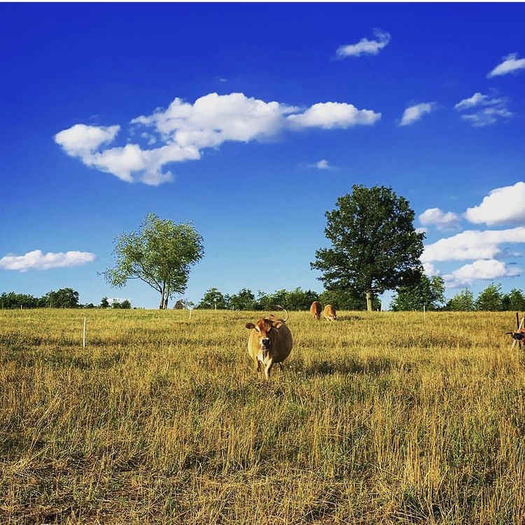
Do you have space and pasture for a cow?
Notes:
Some pasture. Cows are heavy, even mini cows. So the smaller the area, the more mucky it will get. We have beautiful grazing grass in New England but Here in New England we get mud season and hay feeding. The more pasture you have, the less hay you’ll need. Cows need grass, 1.5-2 acres per cow. This will vary based on your property. Start with a little, can always chip away and get more grass. Don’t cut down too many trees, shade is nice for cows.
On our CT farm, we lived on the side of a rock mountain. So every year , we cleared a little bit more and planted grass seed. It wasn’t a twenty acre field, but it was enough during growing season for our one cow and her calf.
Think about waste management as well and zoning issues

Slide 4
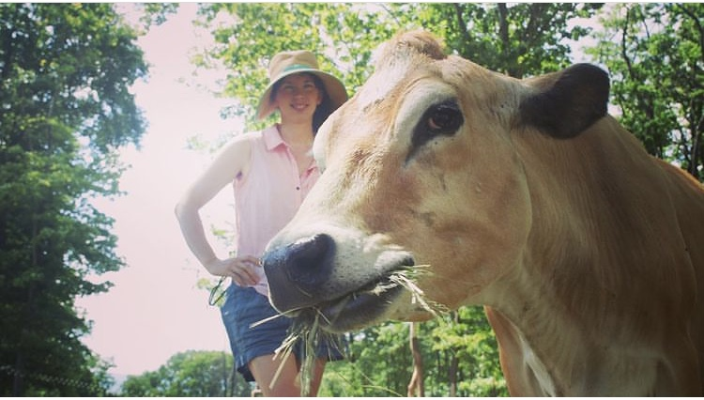
What should you feed a dairy cow?
Notes:
Depending on your pasture, the growth and forage and your cow, hay
Higher producing cow: more protein
Grain mix
Sunflower seeds
Alfalfa for protein
Beet pulp for carbs to keep her in good condition
Supplement free choice loose vitamins and minerals

Slide 5
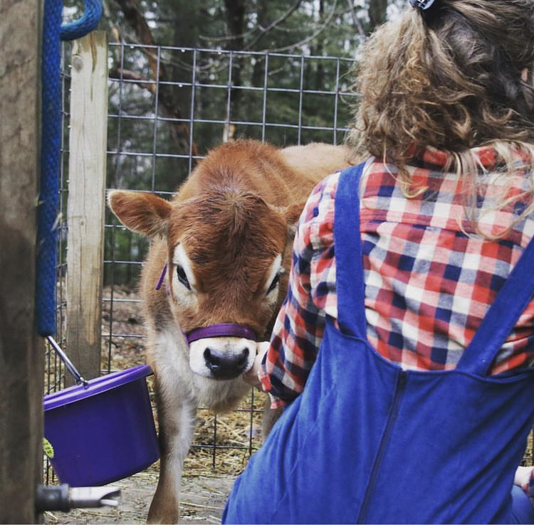
Water
Clean drinking water “is the cheapest and most vital nutrient for dairy cattle”
Notes:
Per unit of body weight, a high producing dairy cow is reported to have a greater water requirement compared to any other land mammal.
Lactating dairy cow will drink 30-50 gallons a day, double when heat stressed
Water, is not easy! ESP in our winters
It’s easy to run hoses, but hauling water in the winter is hard
Heavy
Frost proof hydrant
Heated water trough

Slide 6
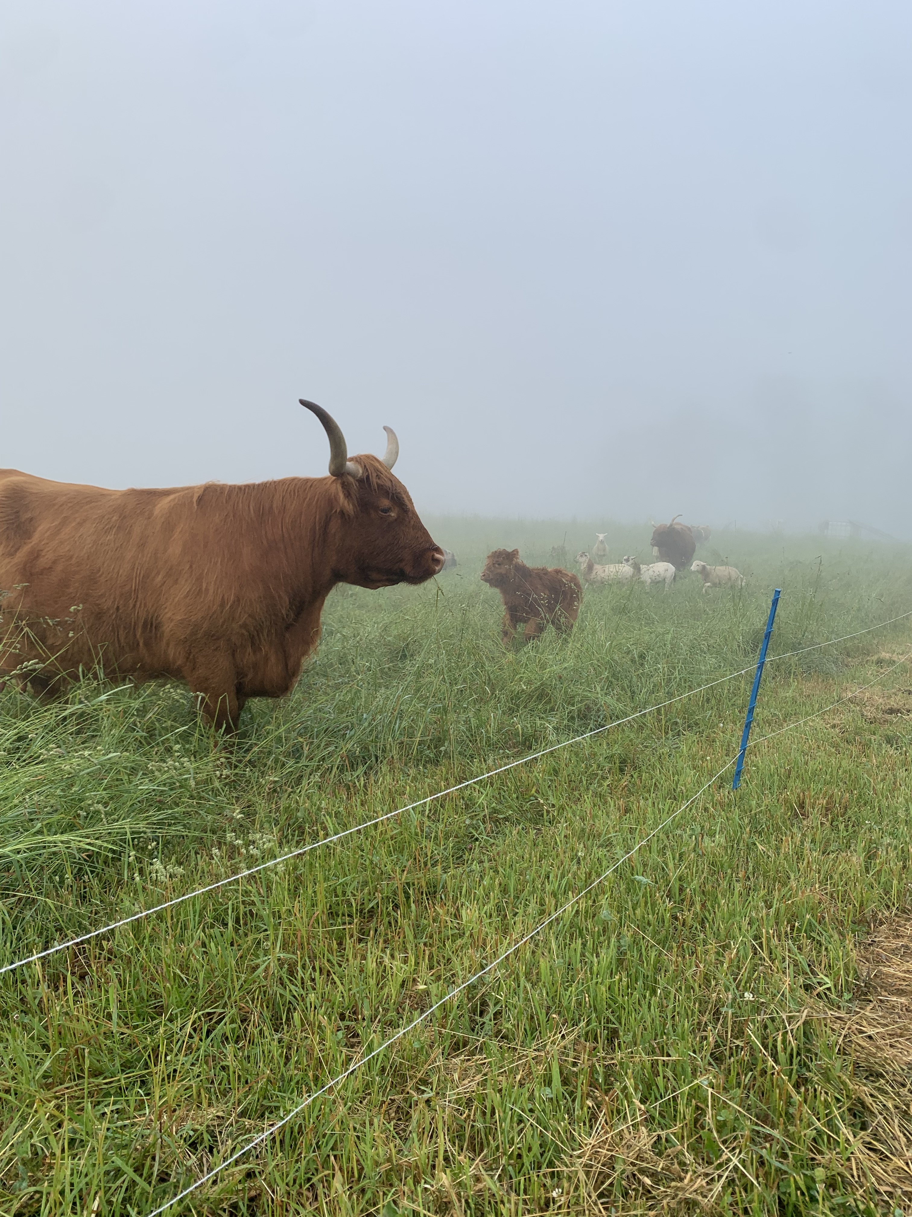
Fencing
Doesn’t need to be too complicated
Notes:
Easier than goats!
High tensile, electric, solar, panels, wire, barbed wire all work well

Slide 7
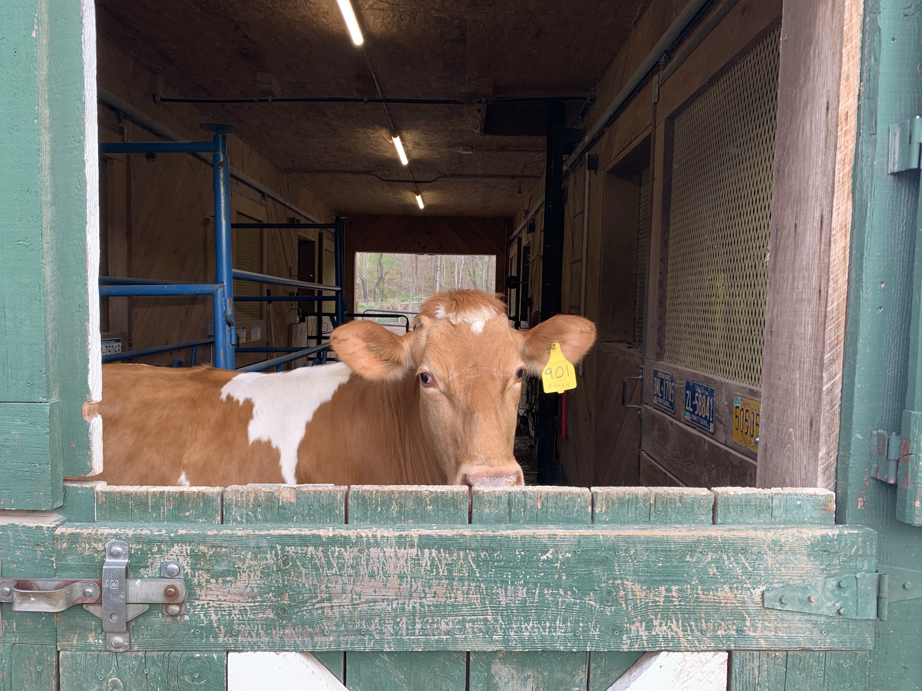
Shelter
Wind break, shelter from rain
Notes:
Shelter:
Our cows have not been delicate creatures.
Even the calves.
They’re more comfortable in cooler temps.
Their room temp is 40 degrees.
They’re thrive in temps downs to 18 degrees, their heavy coats and their rumen acts like a big furnace to keep them warm
One of the reasons that ruminant animals like cattle, sheep, and goats are well-suited to cold climates is due to their rumen. The digestive process that takes place in the four-chambered stomach generates quite a bit of heat. As the rumen breaks down the cellulose material in forage, the tiny microbes anaerobically digest it releasing gas that keeps the animal warm.
It’s good to keep them outside because it can avoid diseases that thrive in close, confined quarters.
So a wind break, a well bedded run-in shelter can be all that’s necessary. Because when they get wet or it’s windy, it’s harder for them to stay warm.
With that, and additional high quality hay or grain to supplement, they’ll do fine in the winter.
They’ll appreciate shade when it’s hot as well

Slide 8
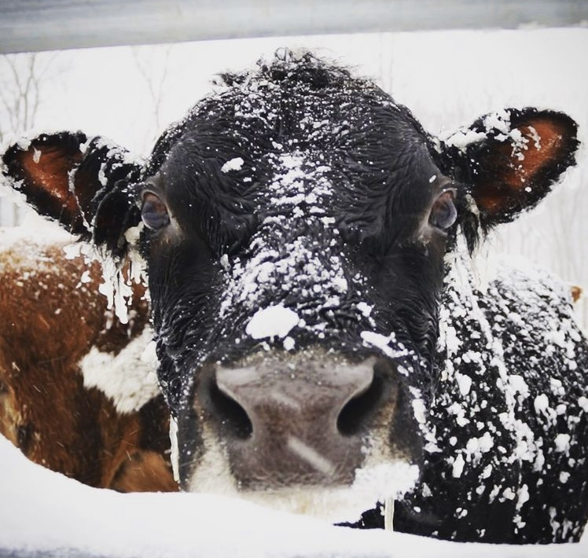
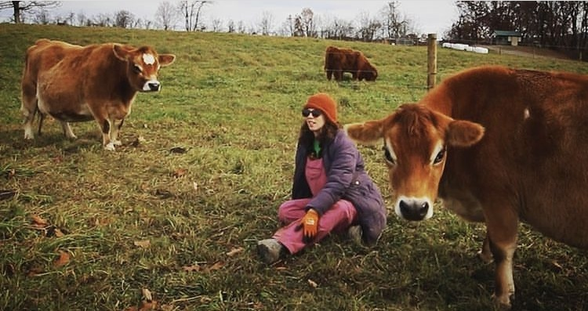
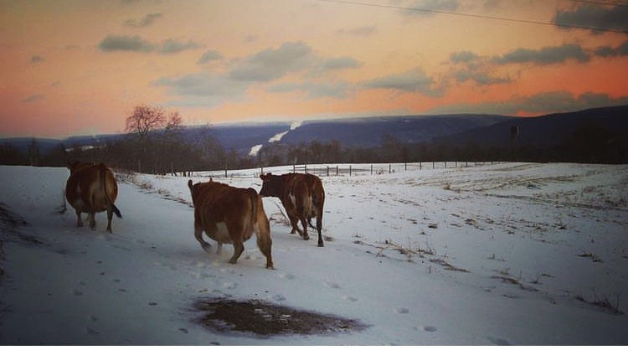
Notes:
Cows are comfortable at cooler temps. No blankets necessary

Slide 9
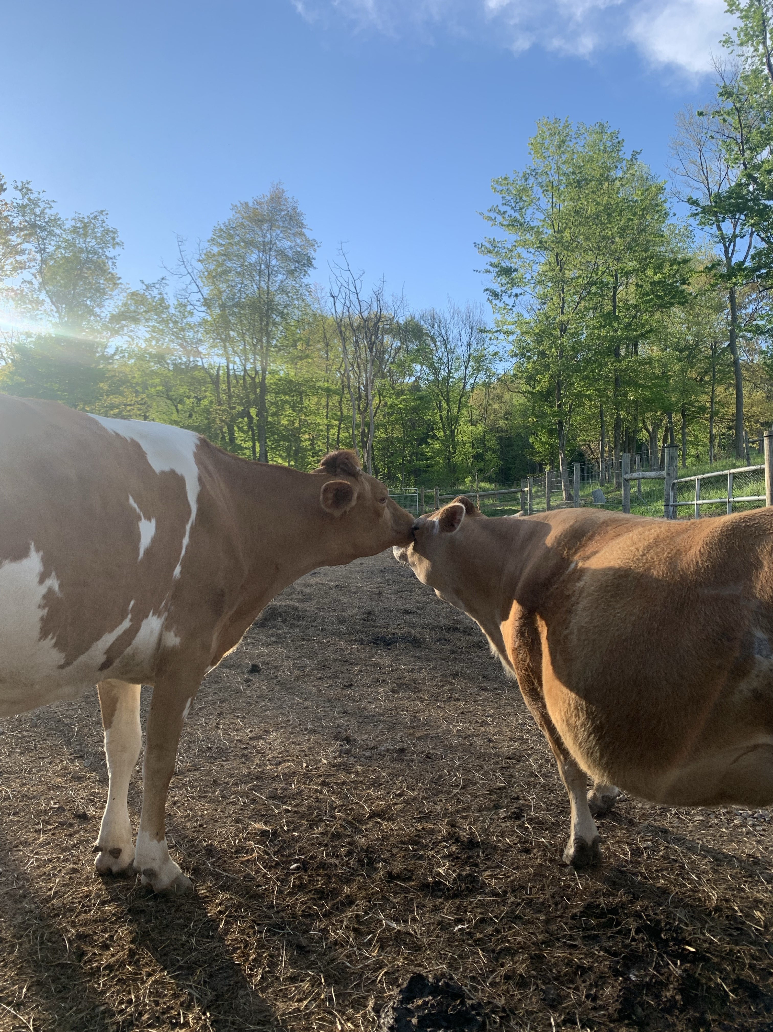
A herdmate
Cows will be happier, healthier and smarter with a companion
Notes:
Cows are herd animals. And we just can’t be part of their herd. They cant play with us. They bond and love their herdMates. Cows have best friends and cows with a buddy are actually smarter
Another cow is best, but you could try a goat or a sheep. Horses can be bossy with cows.

Slide 10
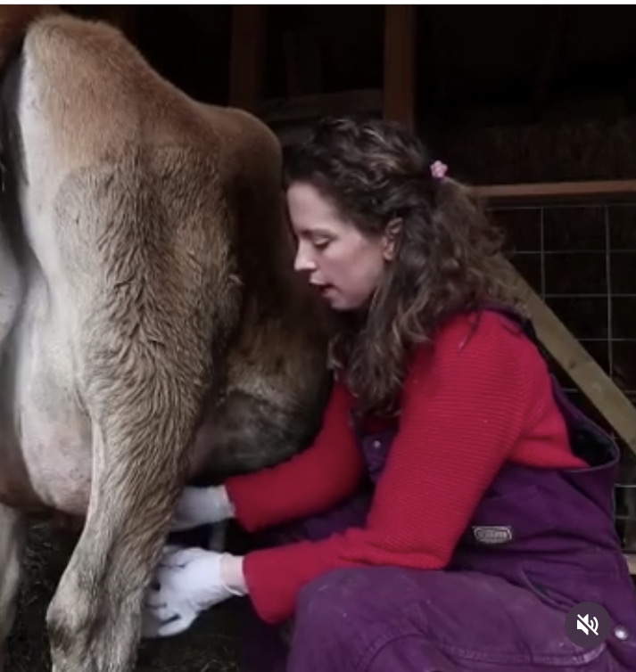
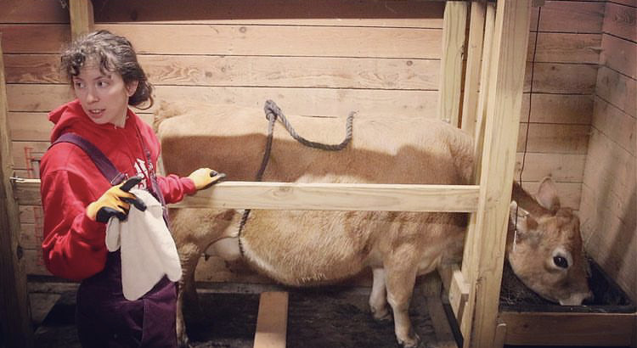
Your Milking Setup
Personalized for you and ever changing
Notes:
Somewhere to milk:
Stanchion, head gate, post
Milking equipment: milk pail, strainer, filters, ball jars something to store milk, rope or kick stop
Don’t go cheap Milker! Good company who can troubleshoot or systems that have been around and parts to rebuild
Be prepared to change, don’t wait til your desperate, just start learning now

Slide 11
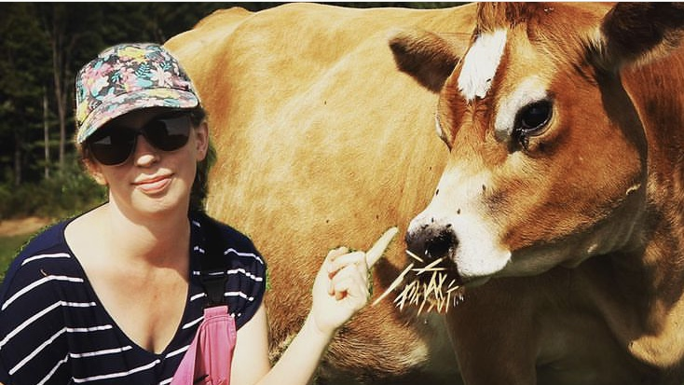
Find your people
Cow Vet, AI tech, hay provider, hoof trimmer, local cow expert, online community

Slide 12
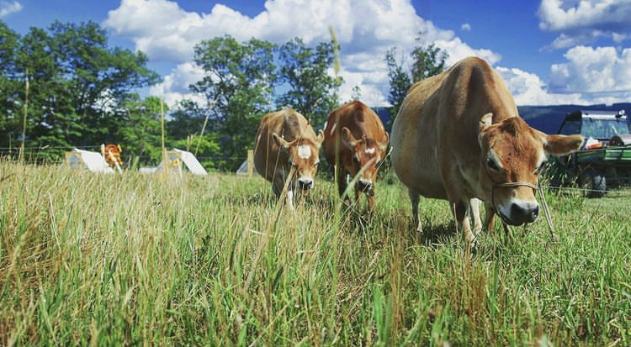
Choosing your cow
Instead of a specific breed, have specific goals in mind
Notes:
In New England, so many options for dairy cow
, which can be good but overwhelming
When I was looking, Kerry, American milking Devon, jersey, mini jersey, guernsey, Randall
How to choose right cow?
What are you looking for?
Lots of milk? Easy keeper?
What are you hoping to do? Hand milk or machine milk?
Raise a calf, give milk for house, cream for butter, excess to raise a pig
A2A2
Horns or no? Some heritage breeds keep the horns
Breed?
More milk, more feed=harder cow to keep on grass alone. Commercial dairies have trained professionals who help them figure out the rations to feed their cows. They have it down to a science.
Lower producing cow from dairy could be a good option
Buy an already bred cow. You want that milk, get that “easy” win. Cows are different than chicks. In six months months you’ll have eggs.
Confirm that she is bred! Buy an experienced cow if possible, gentle! Even a gentle cow, can be a pain to milk a first in a new situation.

Slide 13
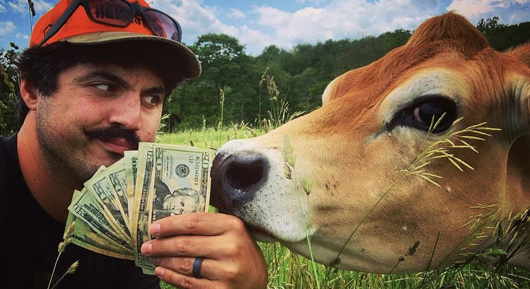
Disease testing
There are benefits even if you’re not worried for yourself
Notes:
Drinking raw milk, drinking milk period. Do research on diseases. Disease testing: Johnes, BLV, bvd, TB, brucellosis
Some people don’t care. If cow looks healthy, milk is good can be a good general rule of thumb.
But some diseases can be transmitted through raw milk. Good to disease test.

Slide 14
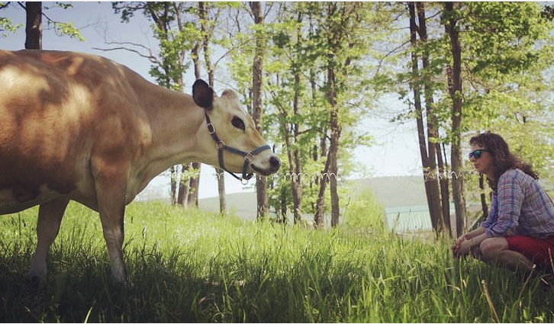
She’s here! Time to settle in and then…

Slide 15
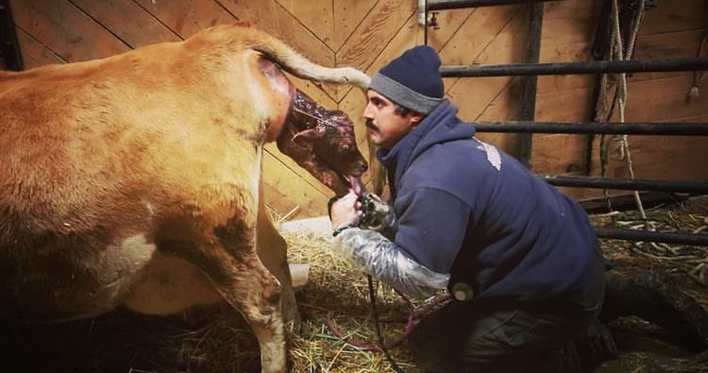
Calving
Exciting and slightly terrifying
Notes:
Ok!! You’re all set up, You’ve got your cow:
Before she calves, she’ll have a two month dry period. She’s not milking, prepping to have her calf.
When she gets close her udder will grow, her vulva will get loose and floppy, vaginal secretions.
Then her udder will seem huge, teats are smooth and strutting
Lots more discharge.
She’ll get++/( up and down, back will hunch and tail will arch
Then two hooves, a nose and the calf!

Slide 16
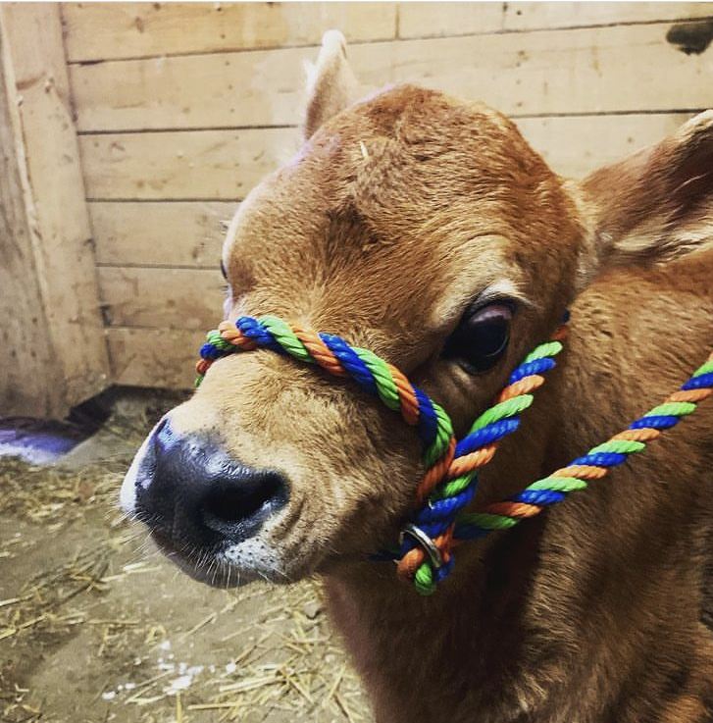
Calf sharing
Do you want cream or a social life?
Notes:
Now is a big decision (hopefully one you’ve made) raise the calf on the dam or raise the calf on Bottle.
Advantages dam raising: easy! Healthy calf, can take time from milking
Disadvantage: you won’t get all the milk or cream, hassle to pull calf when you want milk, hard to wean! Damage to teats
Bottle advantage: friendly calf, all the milk and cream (still have to share with calf if you don’t want to buy milk replacer)
Disadvantage: harder to keep calf healthy, over feeding, under feeding, more hands on with calf
Bull calf- castration
Heifer calf-

Slide 17
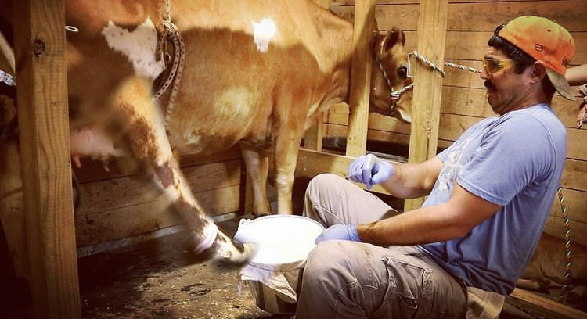
Your first milking
Finally!
Notes:
Milking the morning or night after calving
Lower producing, could just let calf on, but more milking will mean morelllllllllllll”lllllllllllllllllllllllllllllllllllllllllllllllllllllllllllllllllllllllllllllllllllllllllllllllllllll production
Milk her out
Save the colostrum
After a few days, the milk is ready for you to drink!
Keep an eye on the cow, make sure she’s eating or drinking. Call vet if your concerned
Won’t be easy at first
Poop and pee, spilled milk, keep at it
You’ve done it! Milk from your cow. It felt like I climbed a mountain. I could do anything.

Slide 18
Milk
Keep milking area clean
Milk with clean hands
Clean the udder
Keep milking equipment clean
Chill the milk quickly

Slide 19
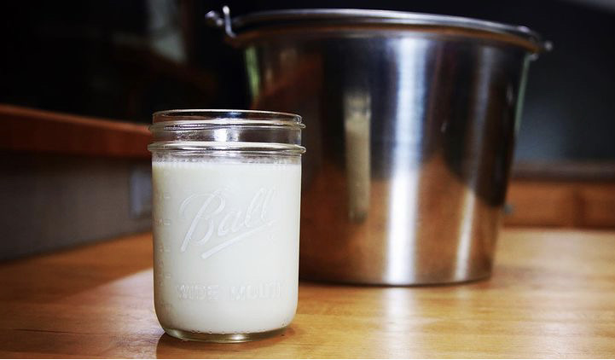
Dairy products
Tackle one at a time and don’t get overwhelmed

Slide 20
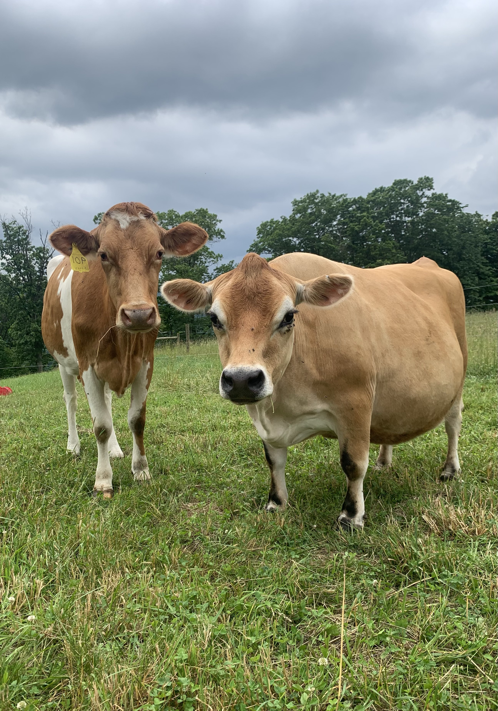
Questions?
Notes:
What steps have you taken to get a cow?
What is holding you back?

