Slide 1
Telling Your Farm’s Story
Morgan Gold of Gold Shaw Farm
September 10, 2022

Slide 2
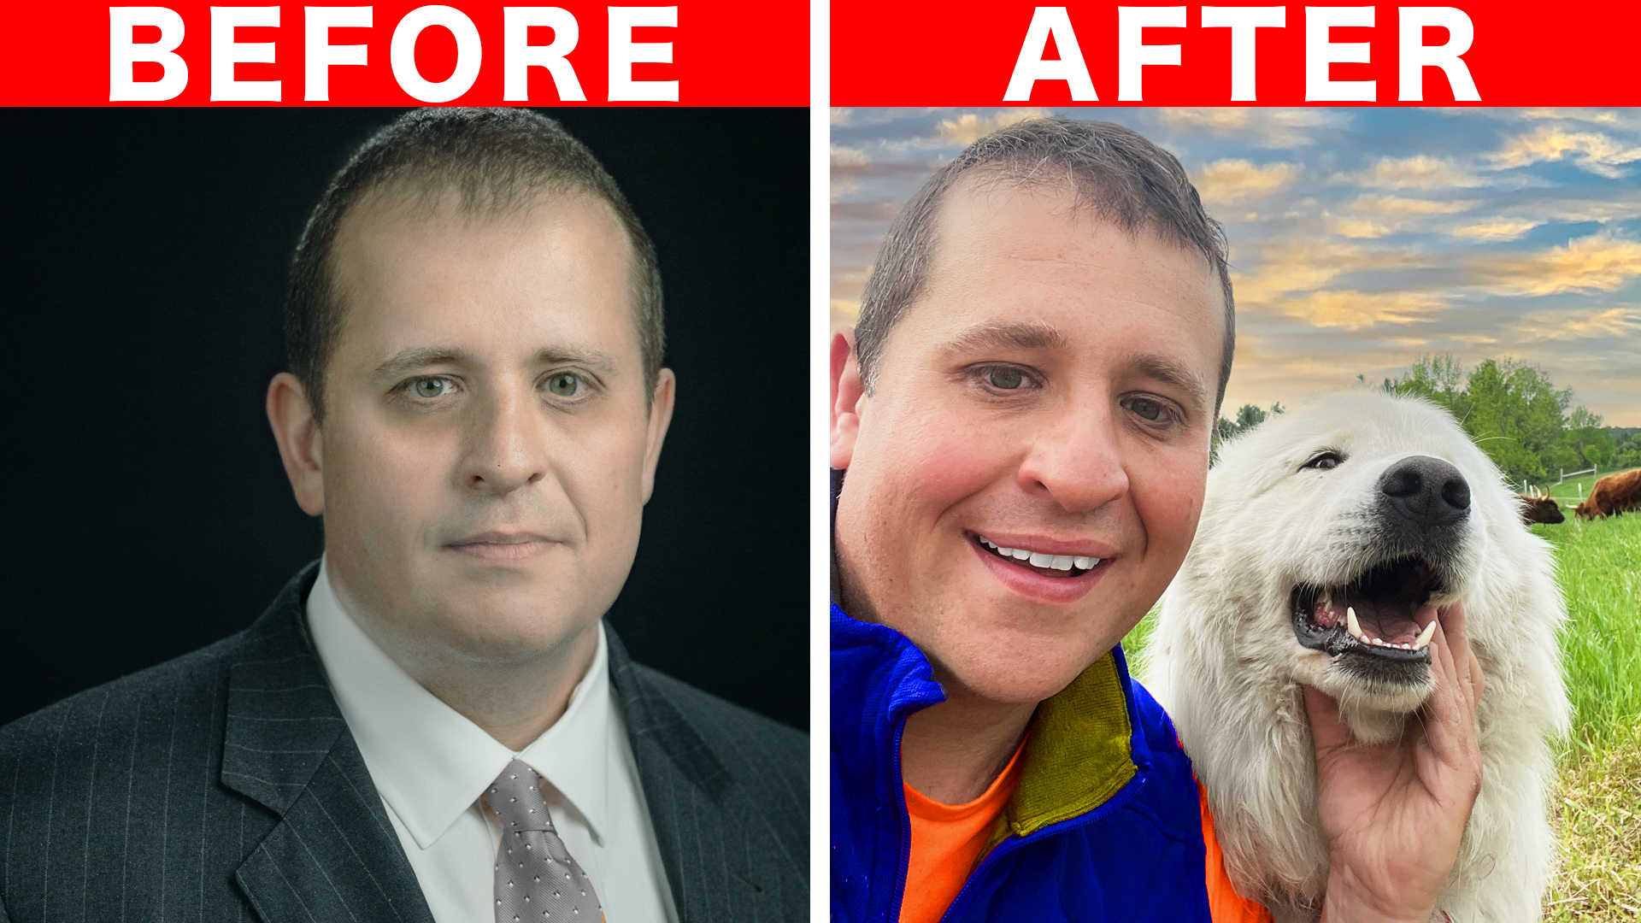
My Story

Slide 3
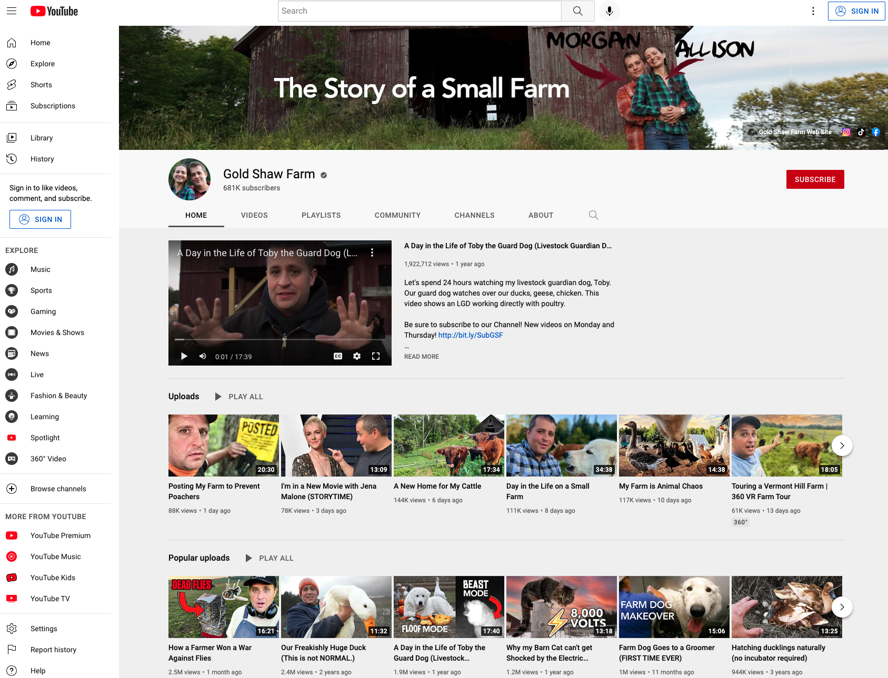
Why Telling Your Story Is Important
Increases visibility of your farm
Adds credibility to your operations
Brings in new business
Inspires others
Creates meaning

Slide 4
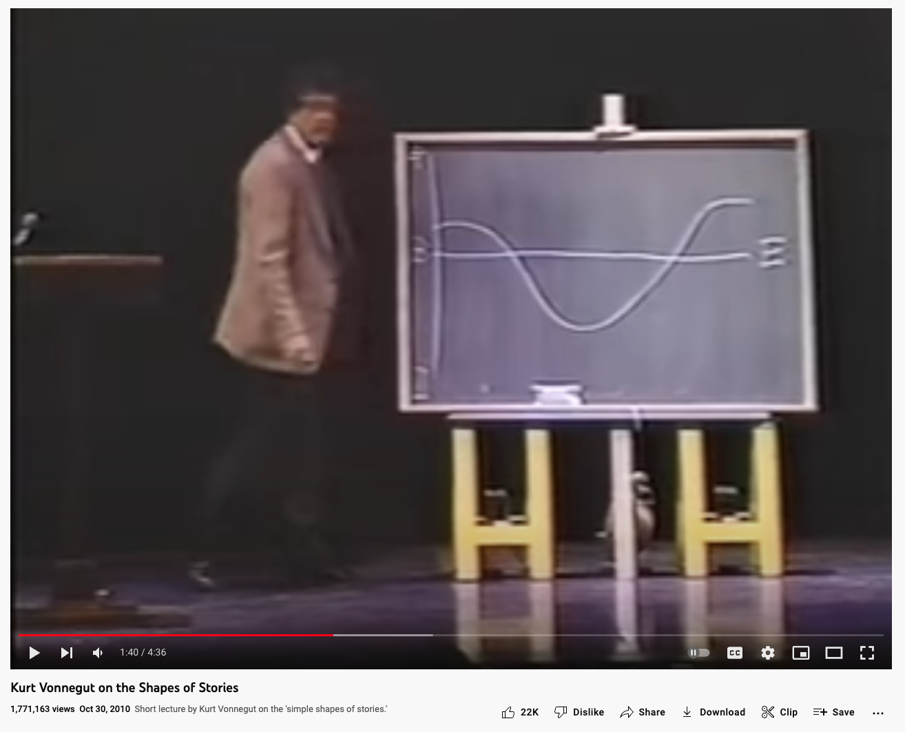
The Shape of a Good Story

Slide 5
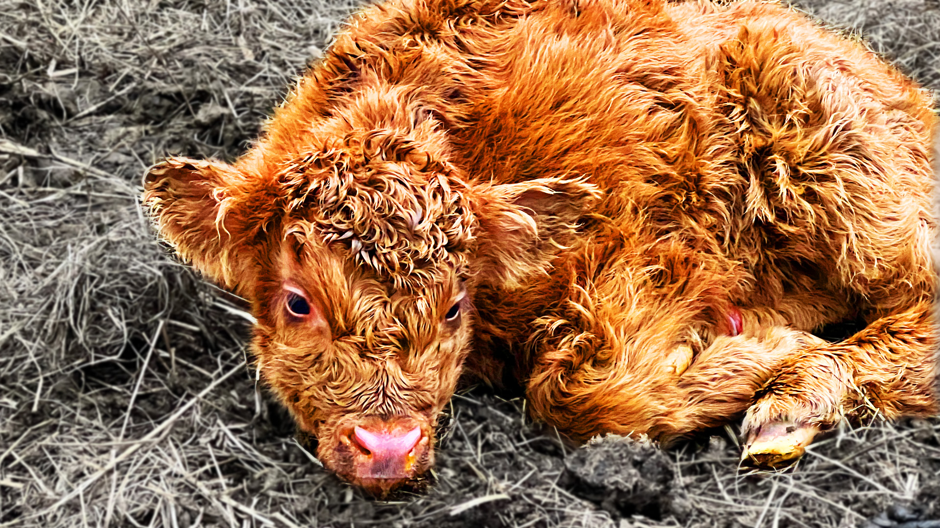
All Good Stories Have…
Setting
Characters
Plot
Conflict
Resolution
Point of View
Theme

Slide 6
It’s not about you.
It’s about them.

Slide 7
It’s better to be different
than to be better.

Slide 8
Different platforms require different storytelling skills.

Slide 9
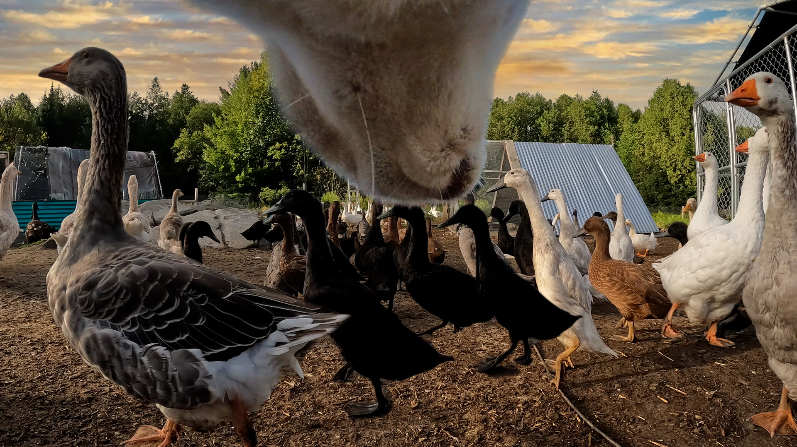
Distilling Your Farm’s Story
Some Questions to Ask Yourself
Who are you?
Why are you different?
What challenges do you face?
Why would a stranger care?
What are the ups?
What are the downs?
What do you want to motivate people to do?

Slide 10
Telling Your Farm’s Story
Questions and Answers
September 10, 2022

